Slide 1
E-Commerce Database Management System
Submitted to: Ms. Kashia Riaz
Contributors:
Saifullah Shaukat, Abdul Hanan
Abdul Rehman, Arif Ali Shah

Slide 2
Project Objective
The primary goal of the EC-DBMS is to establish a streamlined system for customers and vendors, with focus on:
Customer Management: Profiles, preferences, and purchase history.
Vendor Operations: Shop details, product management, sales tracking.
Product Listings: Categorized views, real-time availability.
Order Processing: End-to-end tracking from placement to delivery.

Slide 3
User Roles
Customers:
Can browse, purchase, and track products; manage profiles.
Vendors:
Manage shops, upload products, monitor sales.
System Administrator:
Oversees the platform, verifies vendors, manages categories.

Slide 4
Key Benefits and Challenges
Benefits:
Efficiency
Automation
Data Integrity
Scalability

Slide 5
Relational Database Schema
The database schema includes:
Customer Information: Stores personal details.
Vendor Records: Shop details, product categories.
Order Records: Order status, processing details.

Slide 6
Sample SQL Implementation
Key SQL tables for demonstration:
Customer Table :
Stores customer information, profile details.
Order Table :
Manages customer orders, tracking IDs.
Product Table :
Lists products, categories, availability.

Slide 7
Sample Queries
Example queries include:
Vendor product categories :
`SELECT CategoryName FROM Category WHERE CategoryID IN (...)`
Average customer age :
`SELECT AVG(DATEDIFF(YEAR, DOB, GETDATE())) AS 'Avg Age' FROM Customer`

Slide 8
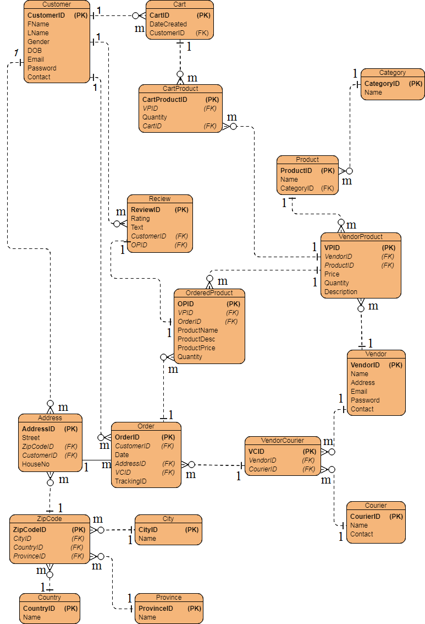
Basic Structure

Slide 9
Conclusion
The EC-DBMS is designed to support e-commerce needs with robust data management, user-friendly interfaces, and scalability for a growing online marketplace. It empowers vendors, ensures efficient order processing, and provides a seamless customer experience.

